Slide 1
Architecture Patterns

Slide 2
Content
Architecture Patterns
Layered Architecture
Event-Driven Architecture
Microkernel Architecture
Space-Based Architecture
Pipeline Architecture
Service-Based Architecture
Service-Oriented Architecture
Microservices Architecture
Examples
Characteristics
Digital Transformation

Slide 3
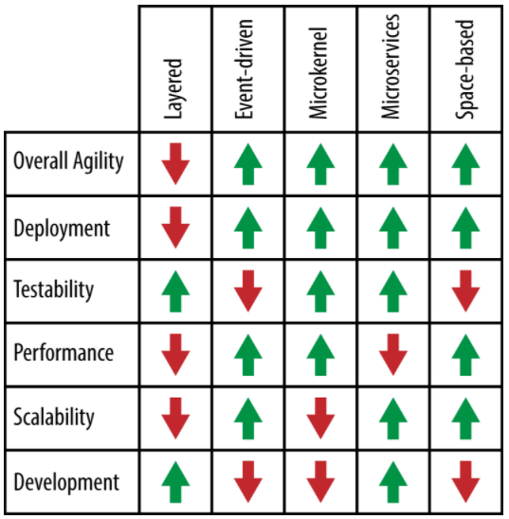
Main Architectures
Layered Architecture
Event-Driven Architecture
Microkernel Architecture
Space-Based Architecture
Microservices Architecture

Slide 4
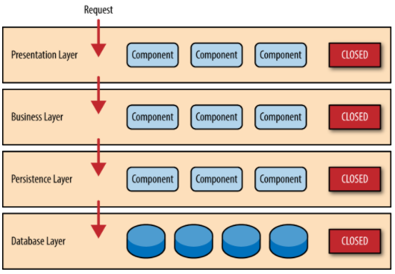
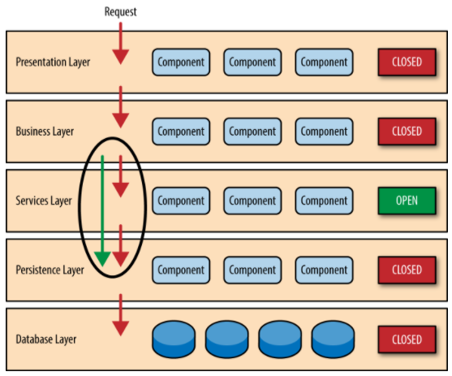
Layered Architecture

Slide 5
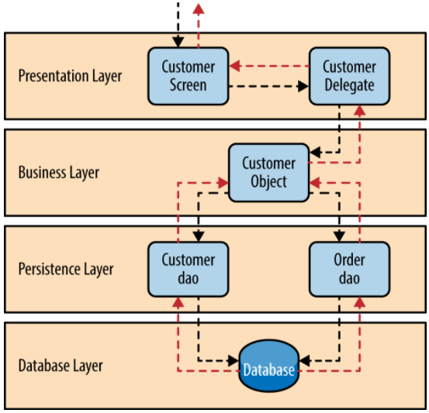
Layered Architecture Example
Orders placed by the customer

Slide 6
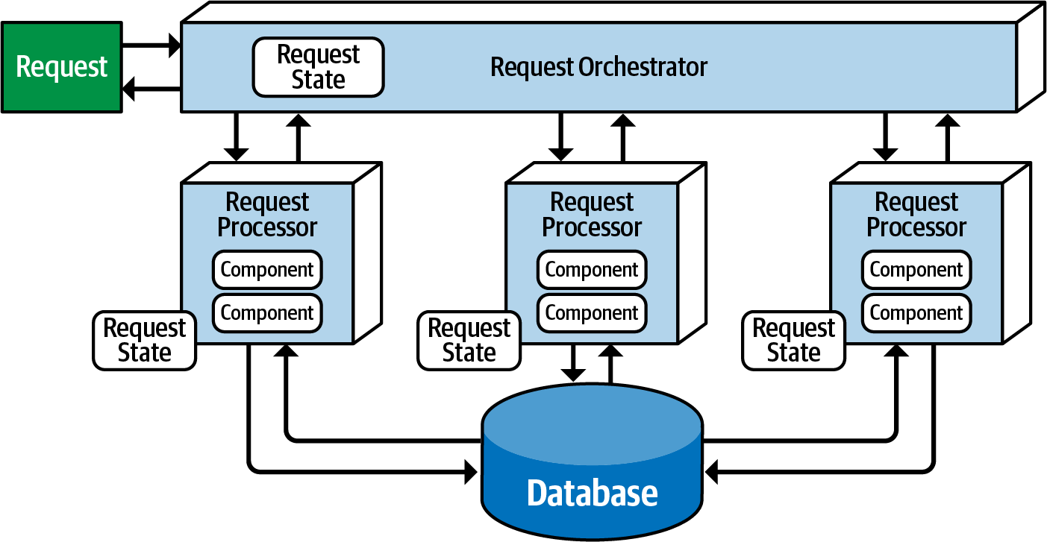
Event-Driven Architecture – Request-based model

Slide 7
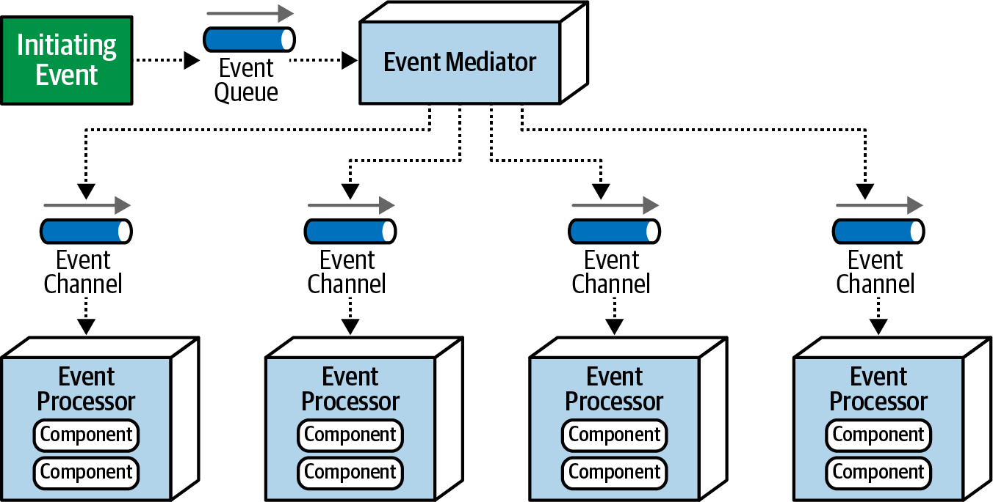
Event-Driven Architecture - Mediator Topology

Slide 8
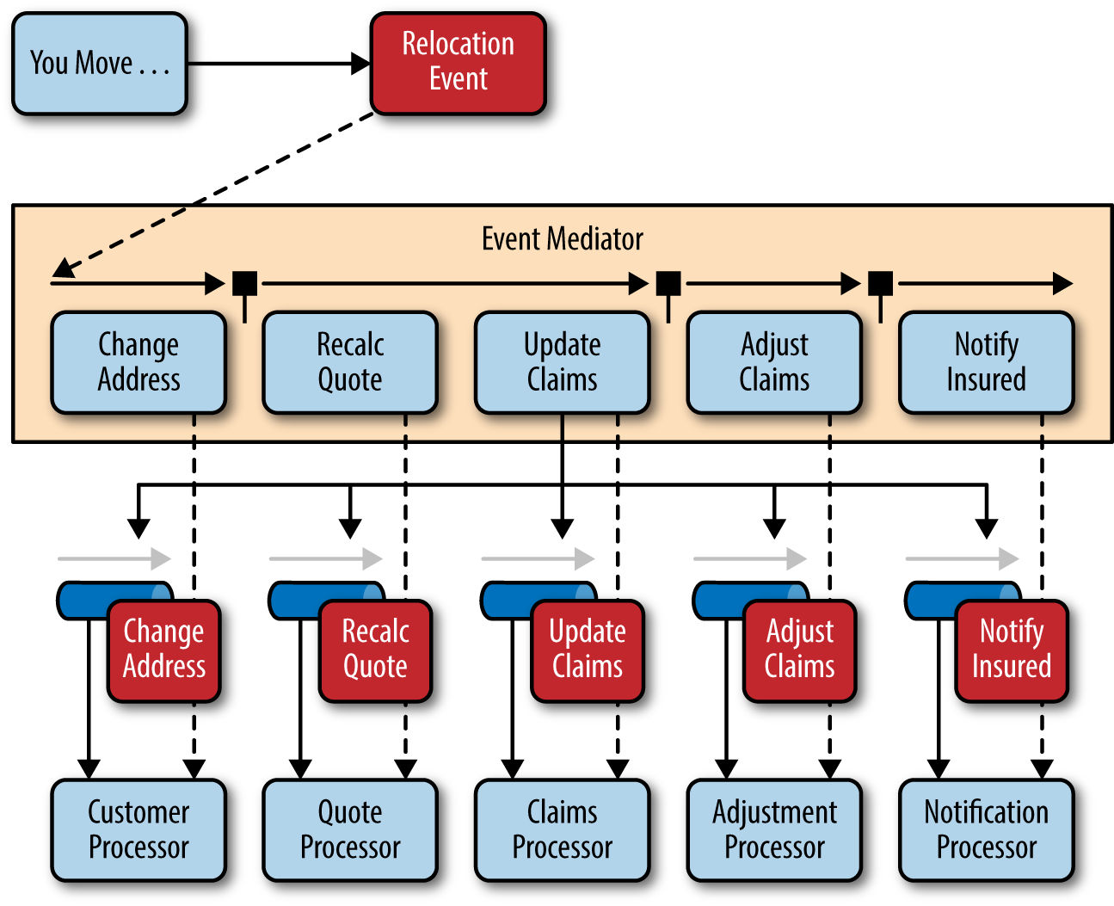
Event-Driven Architecture - Mediator Topology Example

Slide 9
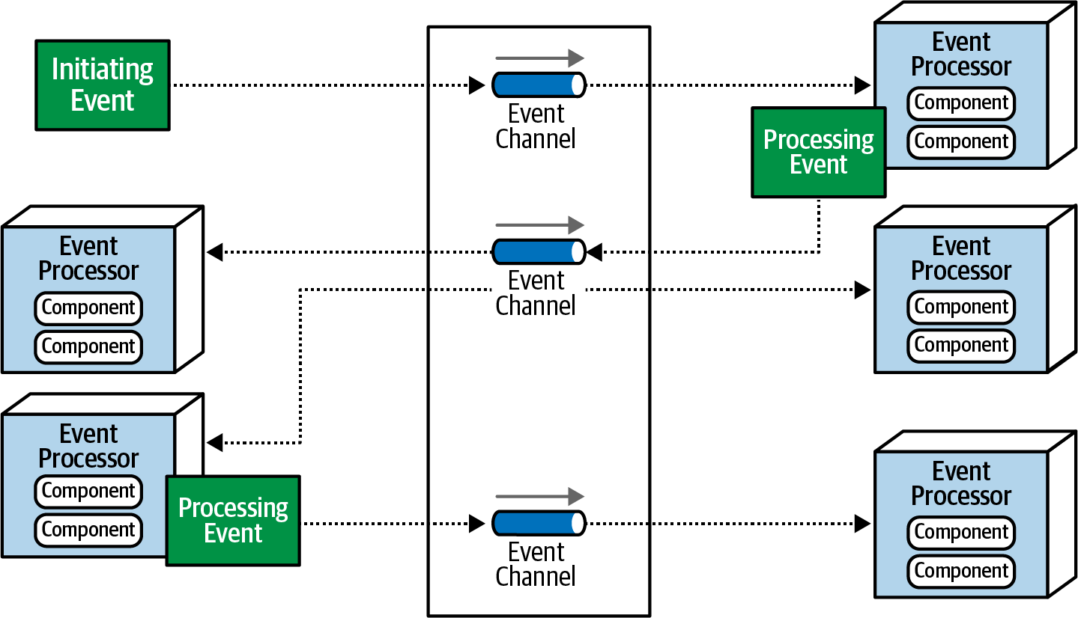
Event-Driven Architecture - Broker Topology

Slide 10
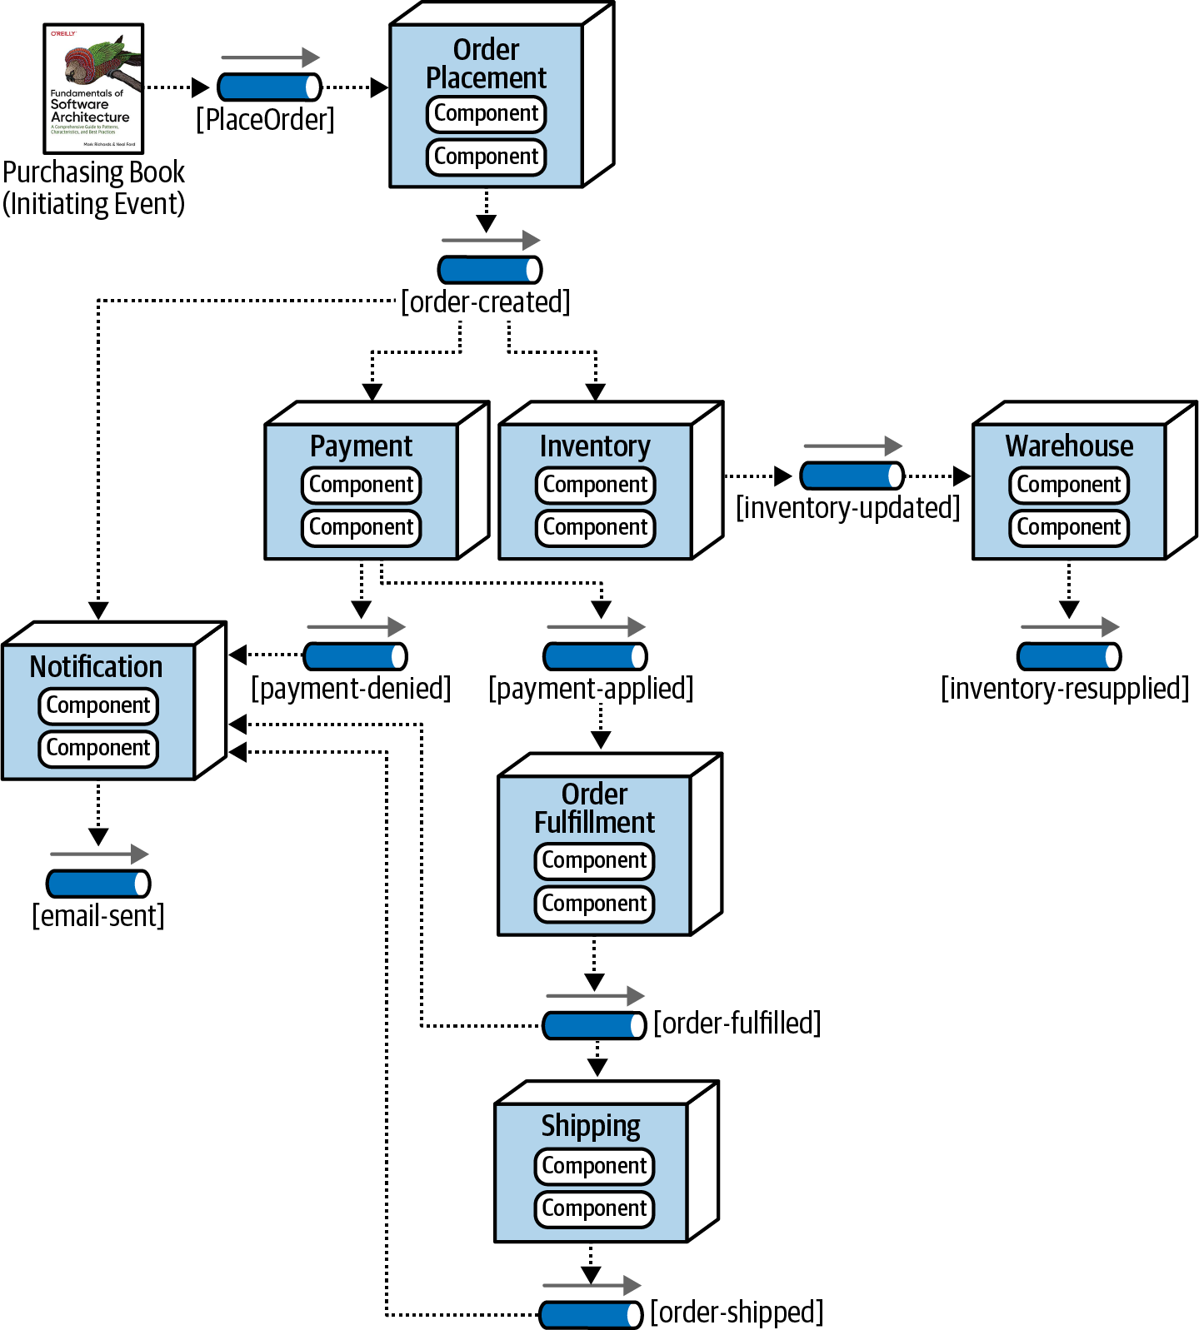
Event-Driven Architecture - Broker Topology Example

Slide 11
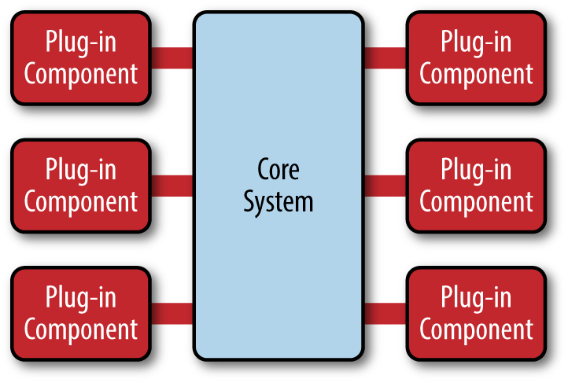
Microkernel Architecture

Slide 12
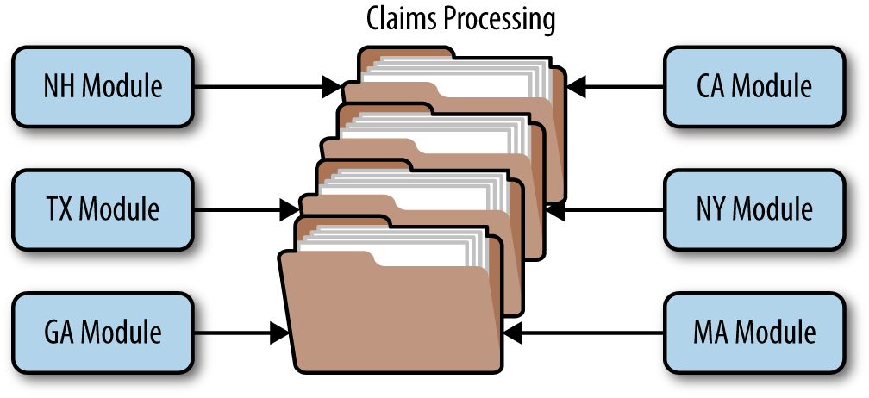
Microkernel Architecture Example

Slide 13
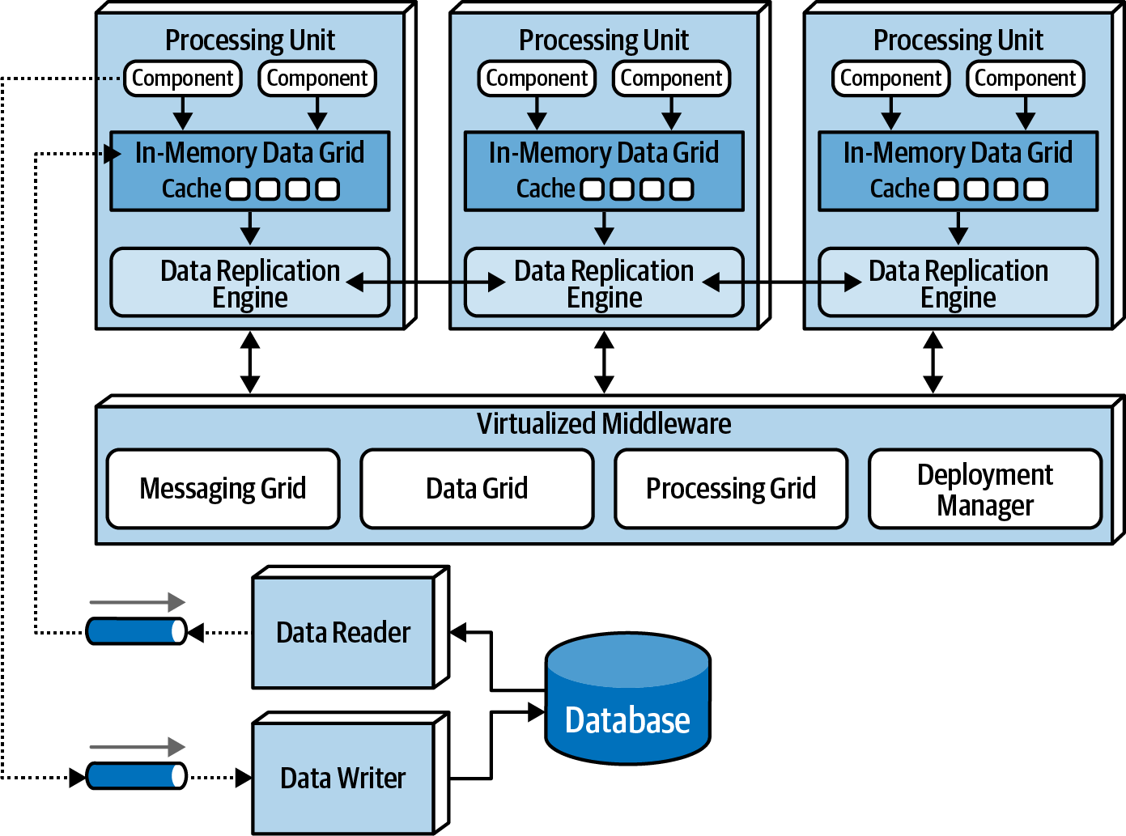
Space-Based Architecture

Slide 14
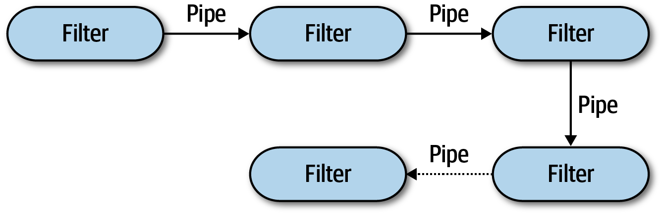
Pipeline Architecture

Slide 15
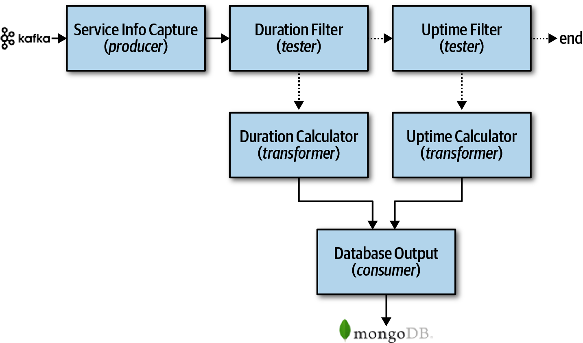
Pipeline Architecture - Example

Slide 16
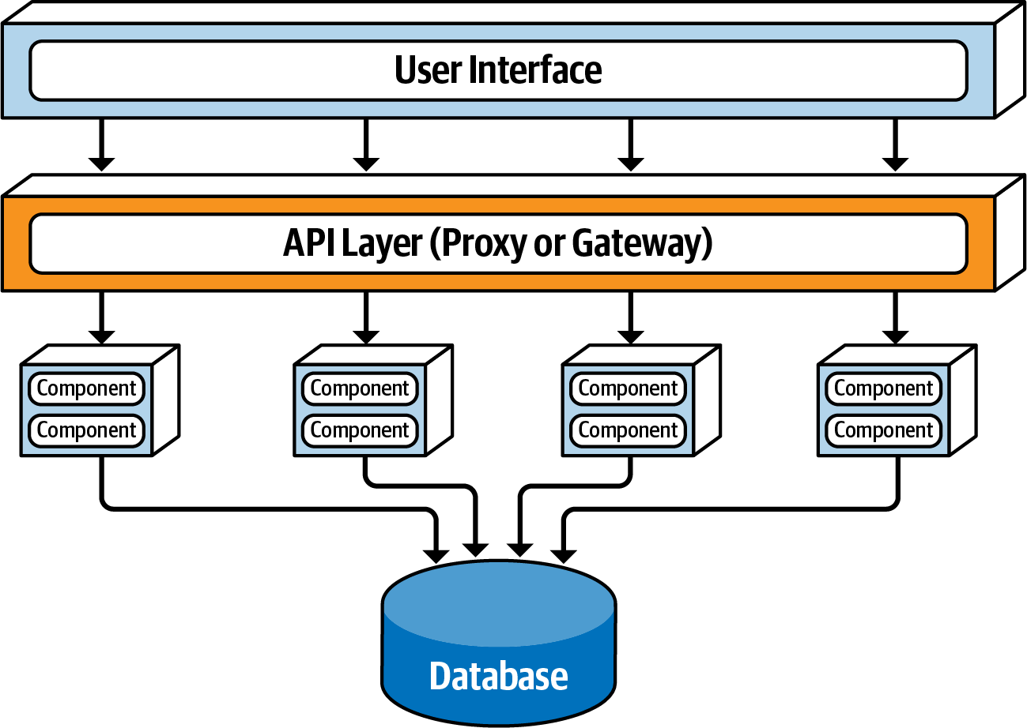
Service-Based Architecture – API Layer

Slide 17
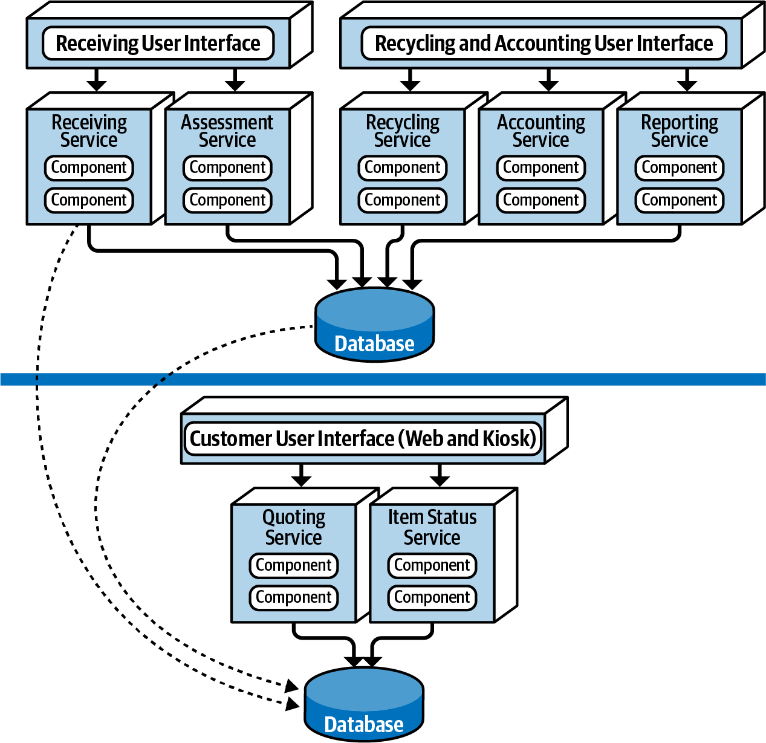
Service-Based Architecture – Example Electronics recycling

Slide 18
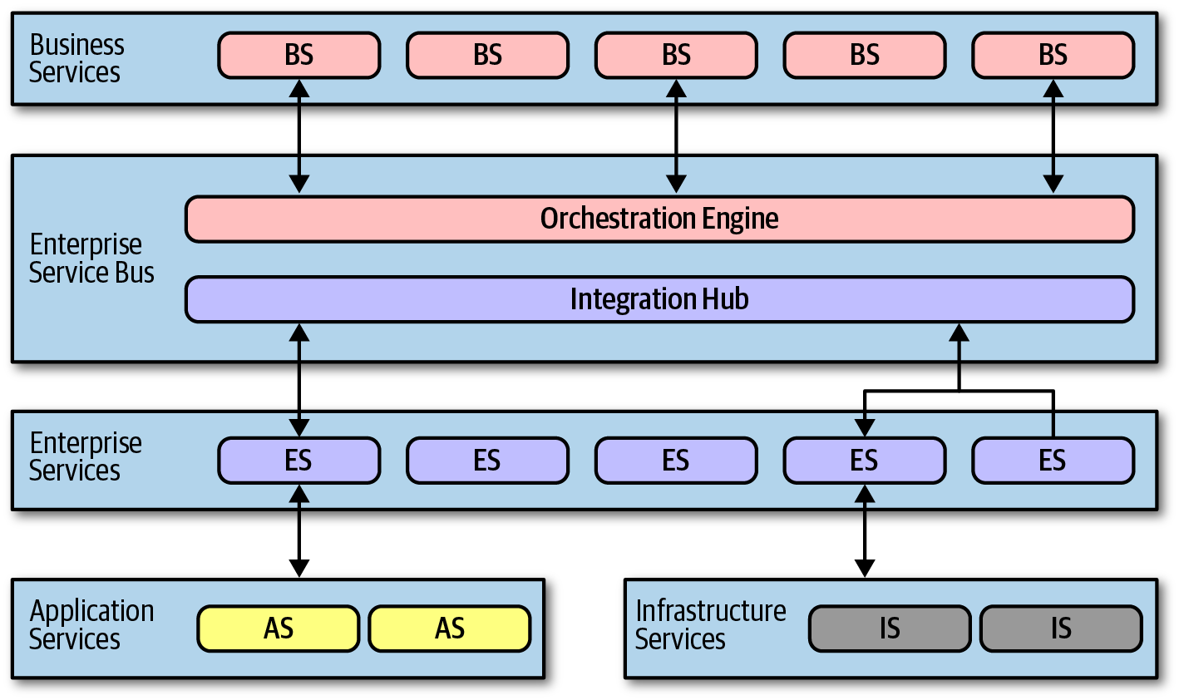
Service-Oriented Architecture (Orchestration-Driven)

Slide 19
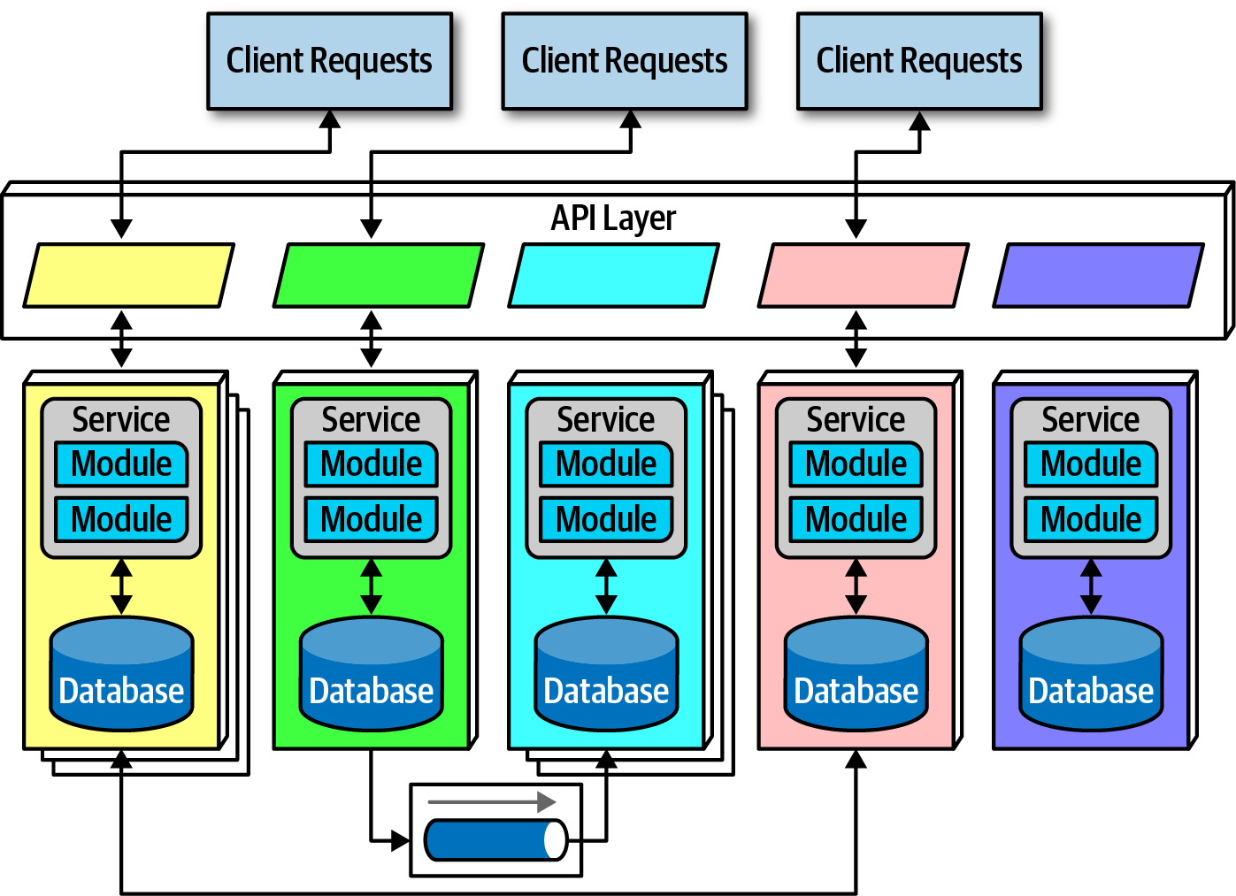
Microservices Architecture

Slide 20
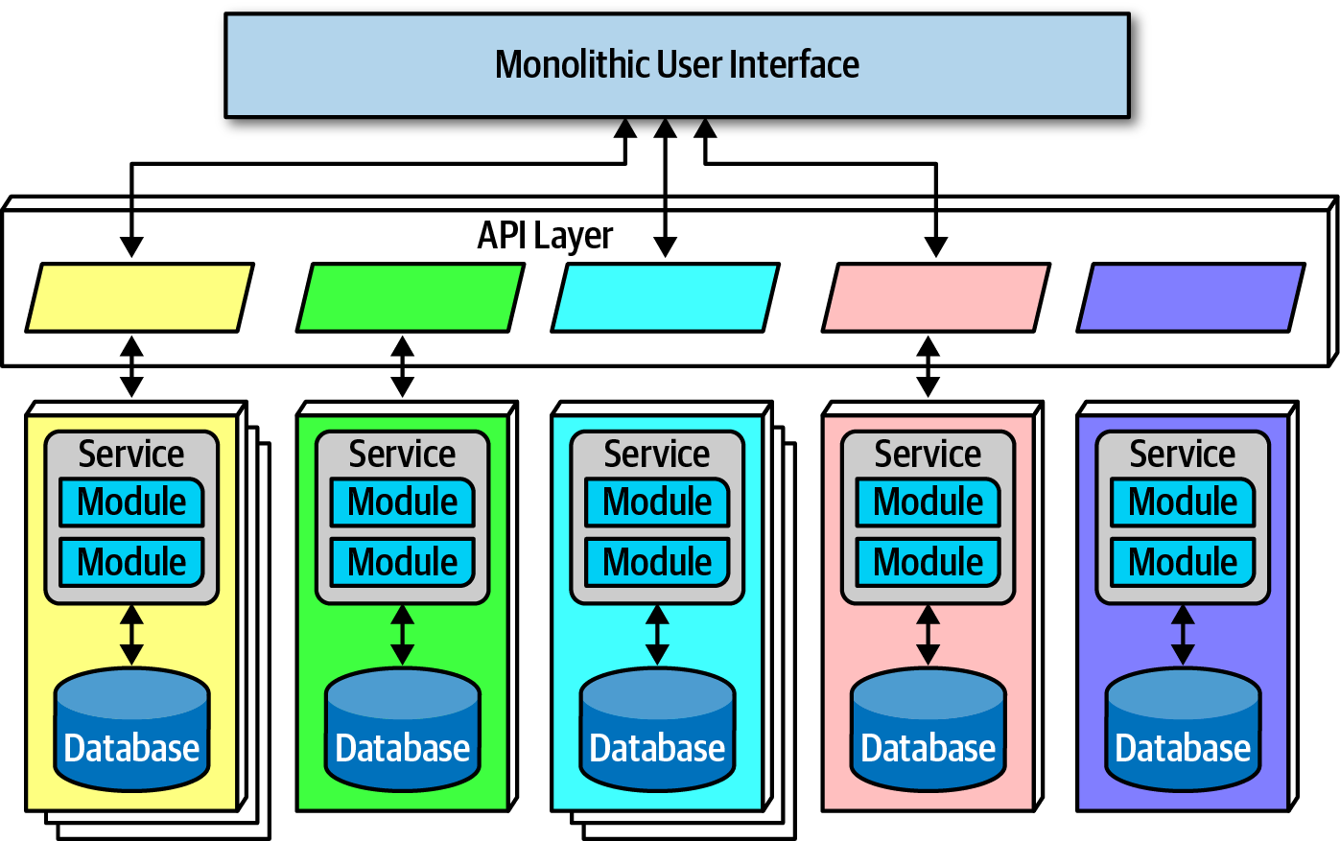
Microservices Architecture - Monolithic UI

Slide 21
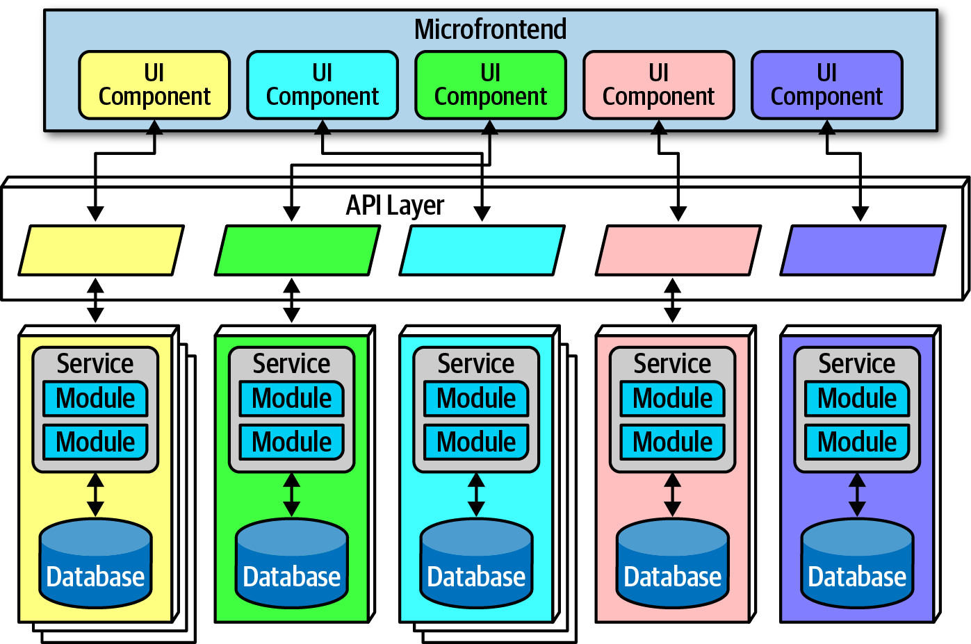
Microservices Architecture - Microfrontend

Slide 22
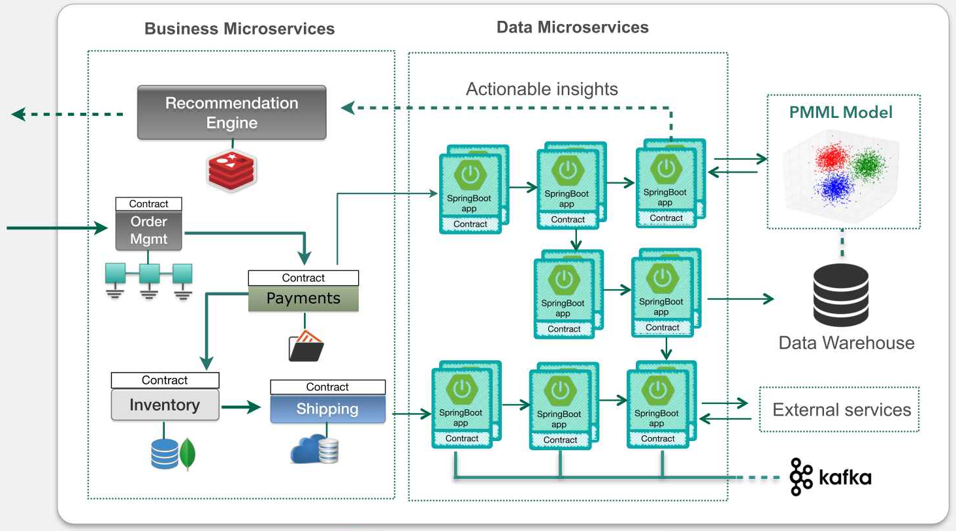
Microservices Architecture - Example

Slide 23
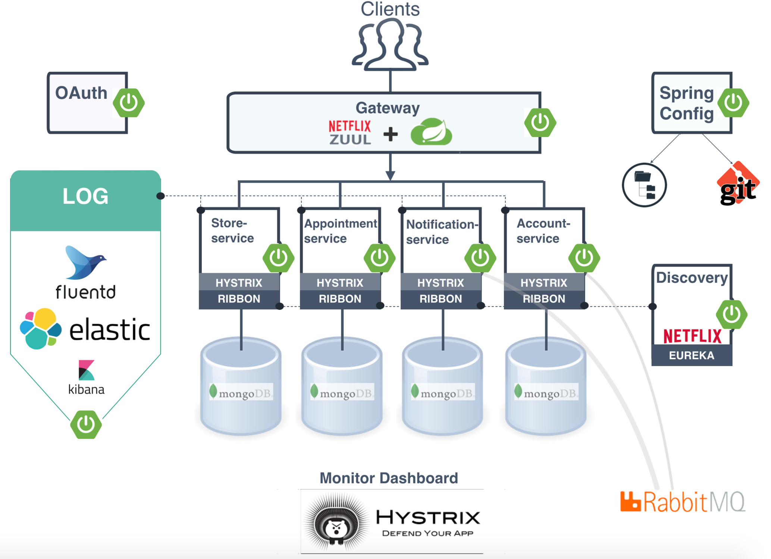
Microservices Architecture - Example

Slide 24
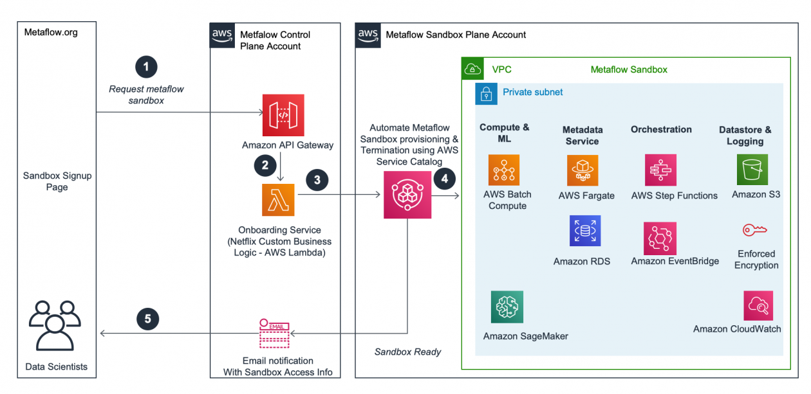
Microservices Architecture - Example

Slide 25
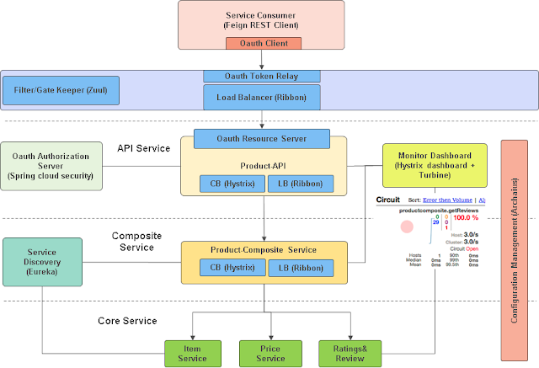
Microservices Architecture - Example

Slide 26
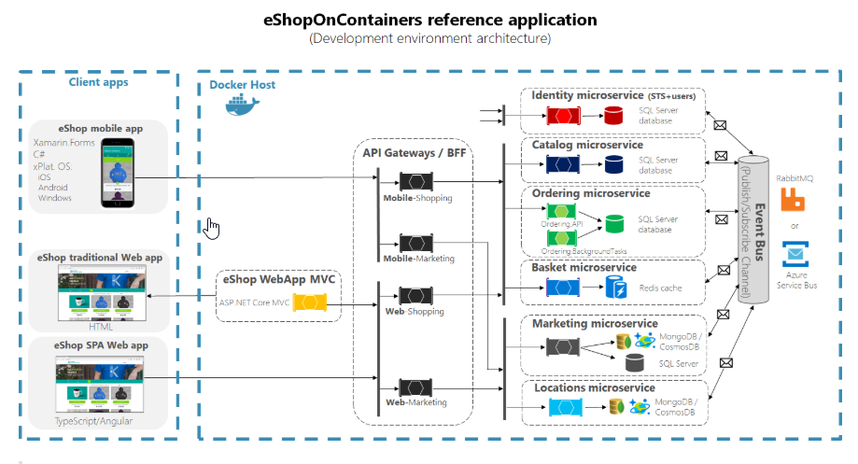
Microservices Architecture - Example

Slide 27
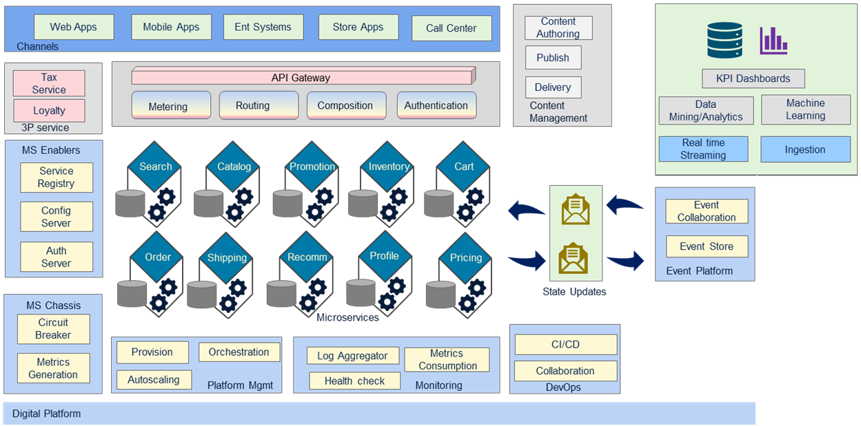
Microservices Architecture - Example

Slide 28
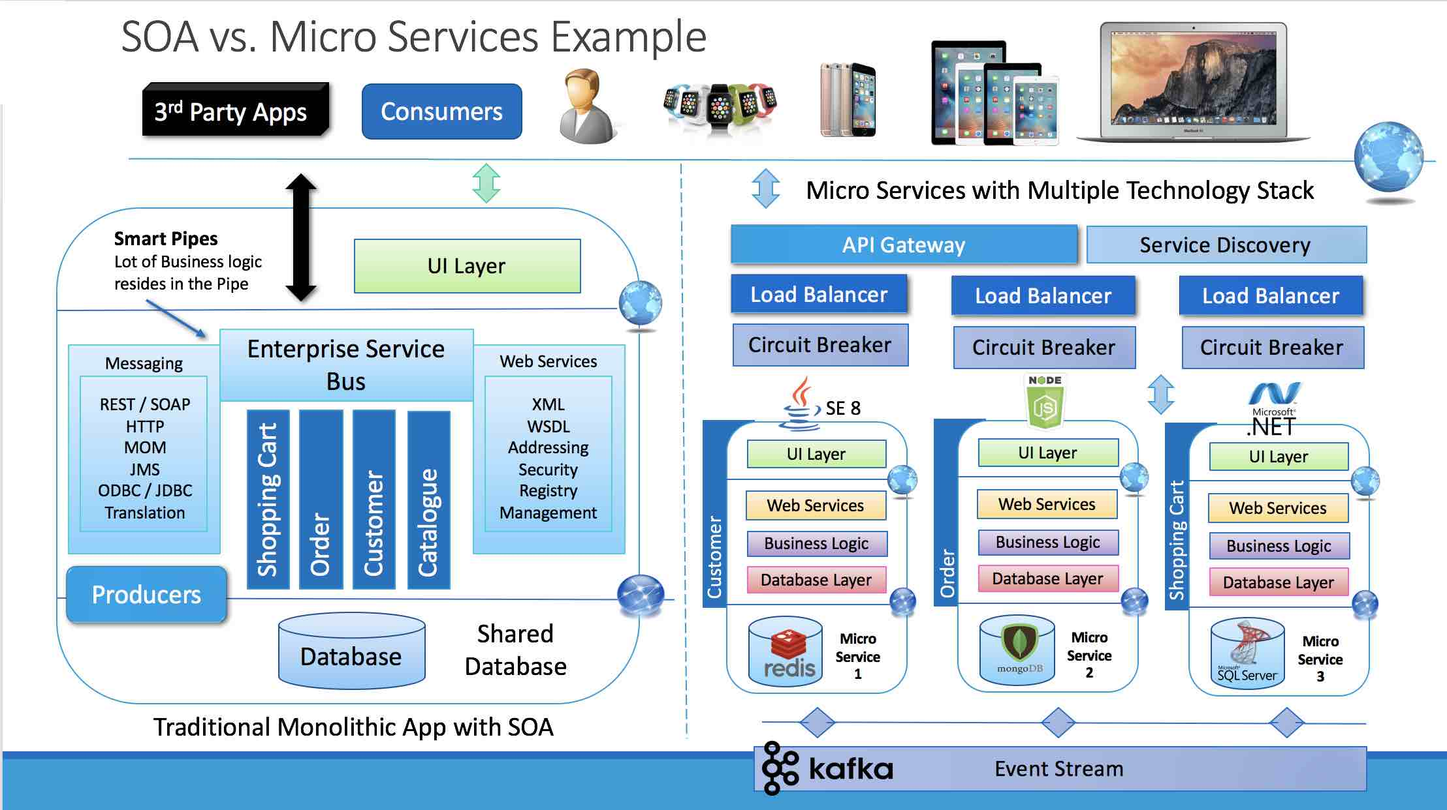

Slide 29
Microservices Arch.
Characteristics Microservices:
Multiple Components
Logical Functionality Boundaries
Easy Routing
Decentralized
Fail-proof
Evolutionary
Salient benefits of microservices:
Independent development & deployment
Fault isolation
Mixed tech stack
Granular (as-required) scaling
Why Microservices?
Due to challenges of Monolithic arch.
Lack of flexibility
Unreliability
Non-scalability
Interdependency
Development pace

Slide 30
Microservices - Digital Transformation
Microservice architectures enable continuous application upgrades, cloud scalability and reusable modules.
API-driven microservices allow separation of distribution from business manufacturing and channels to drive new business models, increasing agility and speeding time to market for apps built digital services.
Microservices is a domain driven design (DDD), and can be designed according and mapping to the business capabilities within a bounded context in different business sub-domains.
Microservices is a modern architecture that keep pace the business and consistent with the business sub-domain separation, scaling and flexibility.

Slide 31
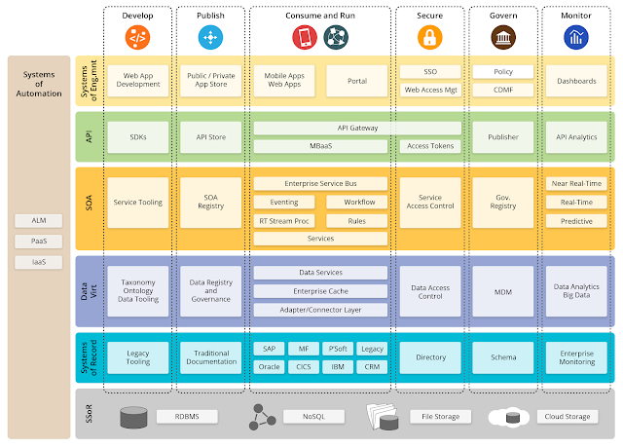
Platform for your Digital Transformation

